Slide 1


Session 2 (DAY 2) Statistical and Machine Learning Models Workshop on Quantitative Literacy and Statistics

Slide 2
Session 2: Part 1 Supervised Learning Workshop on Quantitative Literacy and Statistics

Slide 3
Statistical Learning
Supervised Learning
Unsupervised Learning
Regression
Classification

Slide 4
Supervised Learning

Slide 5

Supervised Learning
Learning techniques to find a function to predict a response variable from set of dependent variables
Dependent/Predictor Variable
Independent/Response
Variable
$$Y=\hat{f}\left(x\right)$$

Slide 6



Supervised Learning: Regression
Learning techniques to find a function to predict a continuous response variable from a set of dependent variables
Weight
MPG
$$MPG=f\left(Weight\right)$$

Slide 7


Supervised Learning: Classification
Learning techniques to find a function to predict a categorical response variable from a set of dependent variables
Cholesterol Level
Get a Heart Disease or Not
$${\text{Heart} \text{Disease}}_{(Yes or No)} =f\left(\text{Cholesterol} \text{Level}\right)$$

Slide 8
Regression

Slide 9
Linear Regression

Slide 10





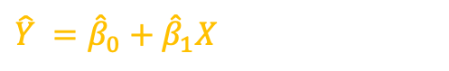



Y - Response
$$\hat{Y} ={\hat{β}}_{0}+{\hat{β}}_{1}X$$
X | Y
$$x_{1}$$ | $$y_{1}$$
$$x_{2}$$ | $$y_{2}$$
$$x_{3}$$ | $$y_{3}$$
$$x_{4}$$ | $$y_{4}$$
$$x_{5}$$ | $$y_{5}$$
$\hat{Y}$ - Prediction
$$e_{5}$$
$$e_{4}$$
$$e_{2}$$
$$e_{3}$$
$$e_{1}$$
X - Dependent
Simple Linear Regression Model: $Y =β_{0}+β_{1}X+Error$
$β_{0}$ - Response when X = 0
$β_{1}$ - Increase of Response when X increase by 1-unit

Slide 11




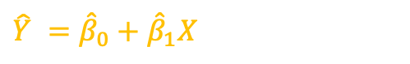



Y - Response
$$\hat{Y} ={\hat{β}}_{0}+{\hat{β}}_{1}X$$
$\hat{Y}$ - Prediction
$$e_{5}$$
Residual: $e_{i}=y_{i}−\hat{y_{i}}$
$$e_{4}$$
Residual Sum of Square: RSS = $e_{1}^{2}$+ $e_{2}^{2}$+ $e_{3}^{2}$+ $e_{4}^{2}$+ $e_{5}^{2}$
$$e_{2}$$
$$e_{3}$$
RSS = $\sum{{\left(Y −\hat{Y}\right)}^{2}}$
Find $β_{0}$ and $β_{1}$ which minimize the RSS
$$e_{1}$$
X - Predictor

Slide 12
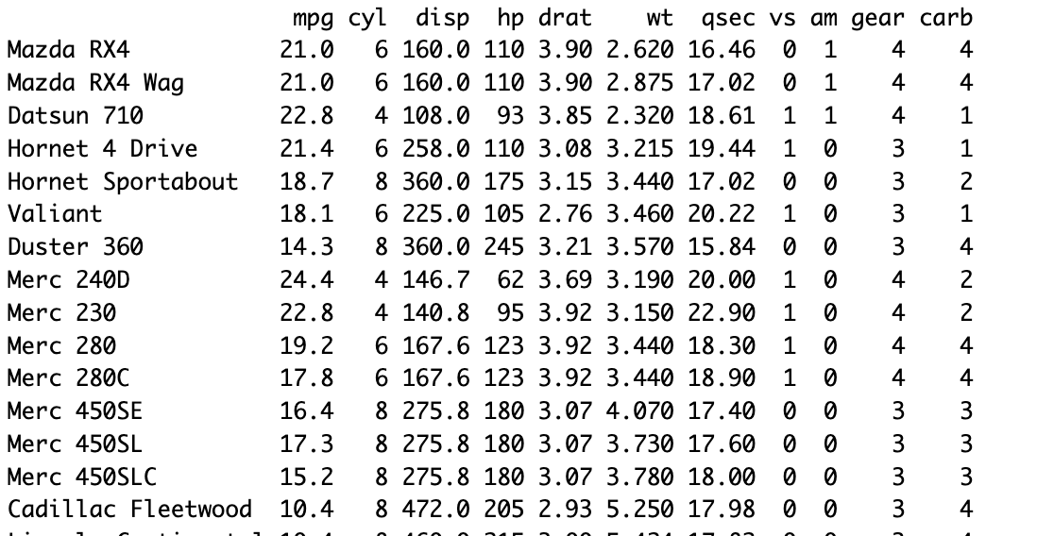

Weight
MPG
$$\hat{MPG} ={\hat{β}}_{0}+{\hat{β}}_{1}Weight$$

Slide 13
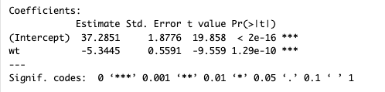



Weight
MPG
$$\hat{MPG} ={\hat{β}}_{0}+{\hat{β}}_{1}Weight$$
lm(formula = mpg ~ wt ,data = mtcars)
$${\hat{β}}_{0}=37.28$$
$${\hat{β}}_{1}=−5.34$$
$$\hat{mpg}=37.28−5.34 Weight$$
p-value will provide statistical significance
$β_{1}−Weight$ is a significant variable in estimating MPG

Slide 14
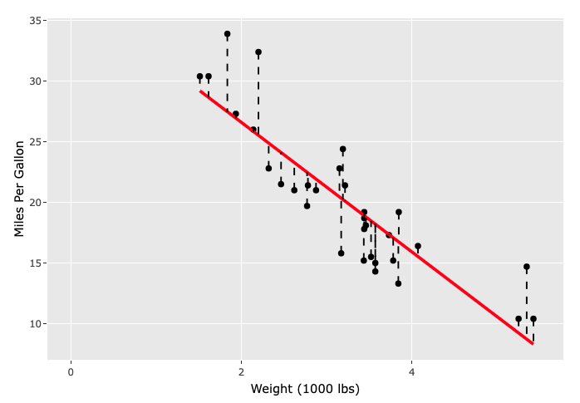

$$\hat{mpg}=37.28−5.34 Weight$$

Slide 15
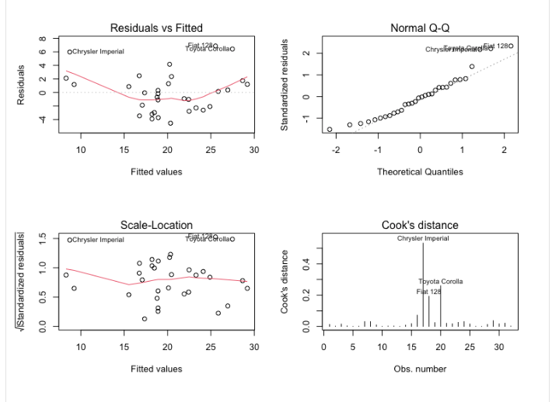
Linear Regression Assumptions
Assumptions
Linearity of Data
Constant Variance of residuals
Normality of Residuals
No Outliers

Slide 16
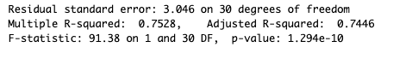

Linear Regression: Evaluation Model Performance
$R^{2}$ - Coefficient of Determination = 0.75
How much variability of response is explained by the input variables
${0≤R}^{2}≤1$
Higher the better
Adjusted $R^{2}$ = 0.74
Panelize for additional input variables
${ R}_{adj}^{2}≤1$
Higher the better
RMSE – Root mean squared error = 3.04
Lower the Better

Slide 17
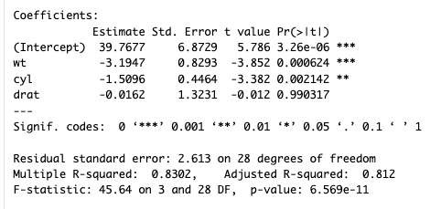


Multiple Linear Regression
$$MPG=β_{0} +β_{1} Weight +β_{2} Cylinders +β_{3} Rear_axle_Ratio + Error$$
multiple_linear_regression = lm(formula = mpg ~ wt + cyl + drat ,data = mtcars)
summary(multiple_linear_regression)
$$R^{2}=0.83$$
$$R_{adj}^{2}=0.81$$
$$\hat{MPG}=39.76 −3.19 Weight −1.51 Cylinders −0.016 Rear_axle_Ratio$$

Slide 18
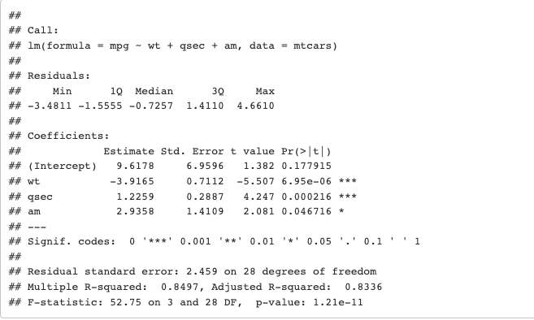
Model Selection: Multiple Linear Regression
Backward Elimination
This method starts with the full model and eliminates unimportant predictor variables from the model.
library(MASS)
full_model_linear_regression = lm(formula = mpg ~ . ,data = mtcars)
backward_model = stepAIC(full_model_linear_regression, direction = "backward", trace = FALSE)
summary(backward_model)
$$\hat{MPG}=9.61 −3.91 Weight+1.22 qsec −2.93 Transmission$$

Slide 19
Model Selection: Multiple Linear Regression
Stepwise Method
Systematically add and remove predictor variables from the model.
library(MASS)
full_model_linear_regression = lm(formula = mpg ~ . ,data = mtcars)
stepwise_model = stepAIC(full_model_linear_regression, direction = "both", trace = FALSE)
summary(stepwise_model)
$$\hat{MPG}=9.61 −3.91 Weight+1.22 qsec −2.93 Transmission$$

Slide 20
Random Forest: Regression

Slide 21
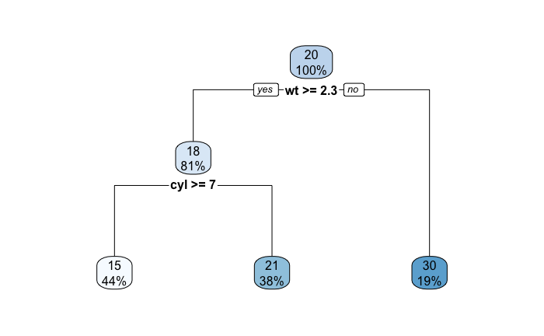
Regression Trees (Decision Trees)
Partition the data set into decision boundaries.

Slide 22
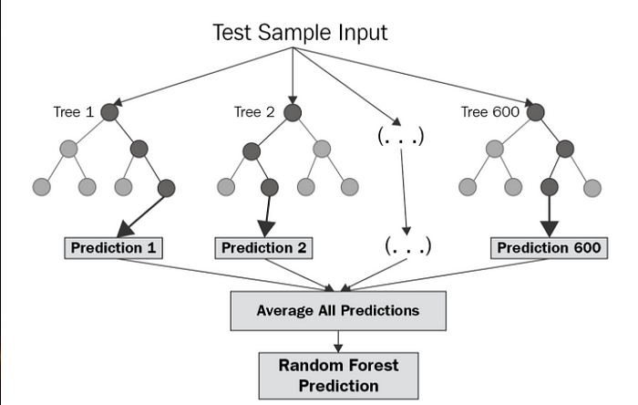
Random Forest Regression use the “Bagging” Technique
Source: https://levelup.gitconnected.com/random-forest-regression-209c0f354c84

Slide 23
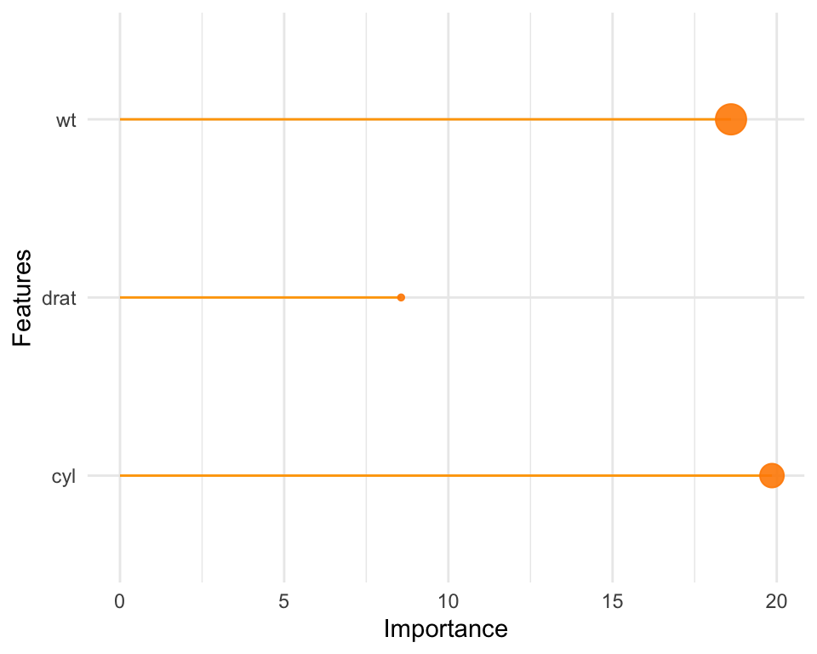
library(randomForest)
Random_Forest_model = randomForest(formula = mpg ~ wt + cyl + drat,
data = mtcars,
ntree=500, importance=TRUE)

Slide 24
Comparison of Linear Regression and Random Forest
Linear Regression | Random Forest
Linear Model Works well when data is linear | Non-linear Model Work well with both linear and nonlinear data Ensemble Technique Take the average prediction of multiple models
Multicollinearity exists Model parameter estimates will not be accurate when there is a significant relationship between input variables (features) | Multicollinearity is not an issue
Model Interpretation A better interpretation of variables | Model Interpretation is moderate Not best as linear regression
Multicollinearity – Input (predictor) variables are significantly correlated

Slide 25
Classification

Slide 26
Cholesterol
Body Weight
No Heart Disease
Hear Disease

Slide 27
Logistic Regression

Slide 28
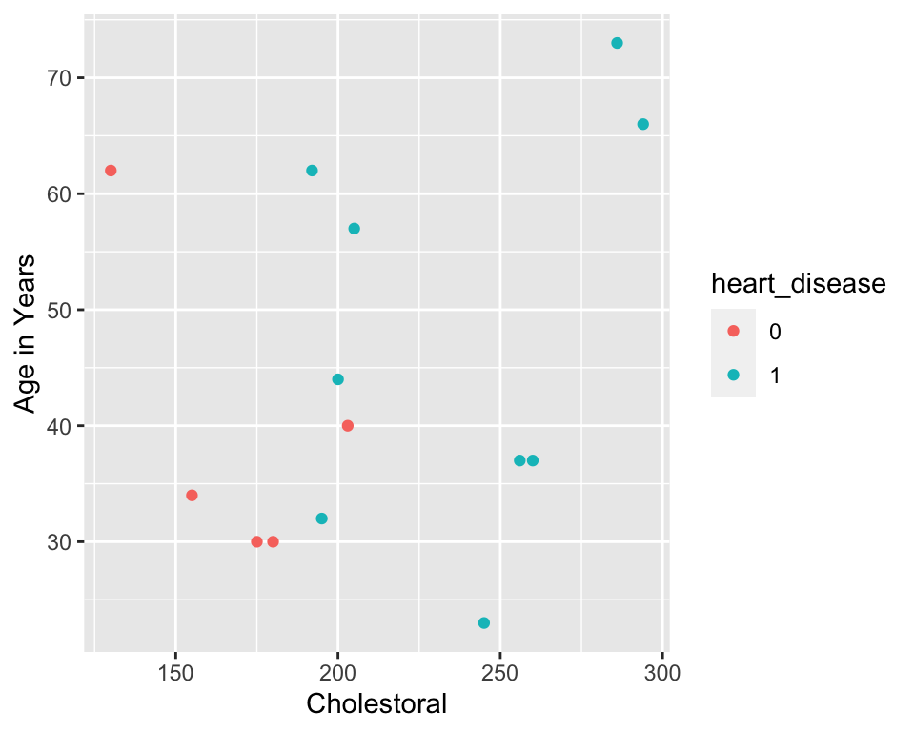
Cholesterol | Age | Heart Disease
180 | 30 | 0
200 | 44 | 1
195 | 32 | 1
245 | 23 | 1
205 | 57 | 1
130 | 62 | 0
155 | 34 | 0
260 | 37 | 1
175 | 30 | 0
286 | 73 | 1
180 | 30 | 0
200 | 44 | 1
195 | 32 | 1
245 | 23 | 1

Slide 29
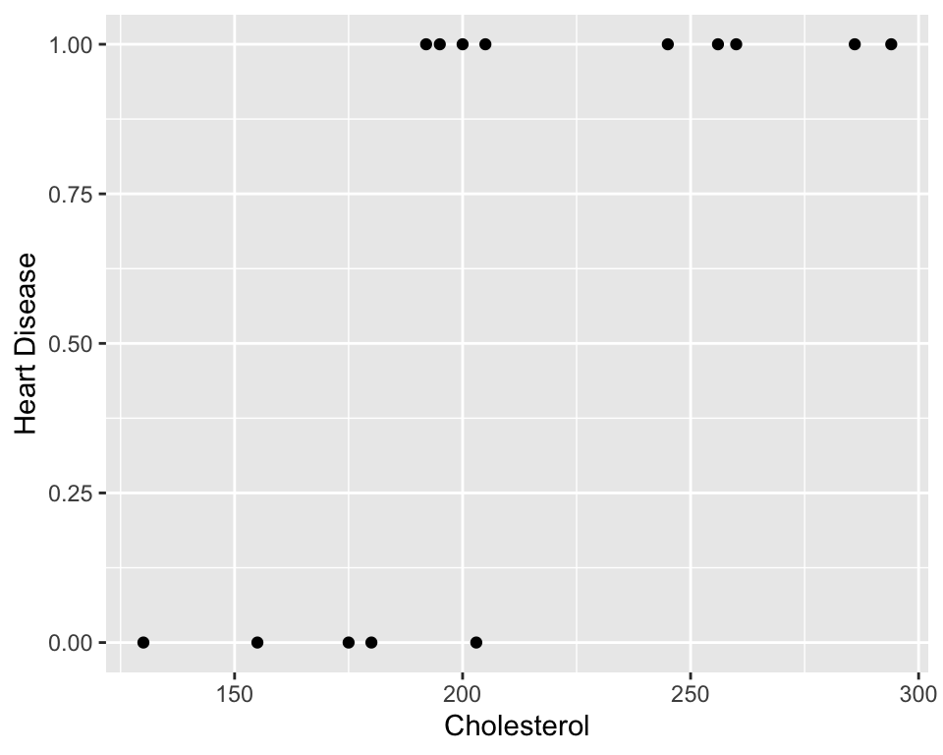

Slide 30
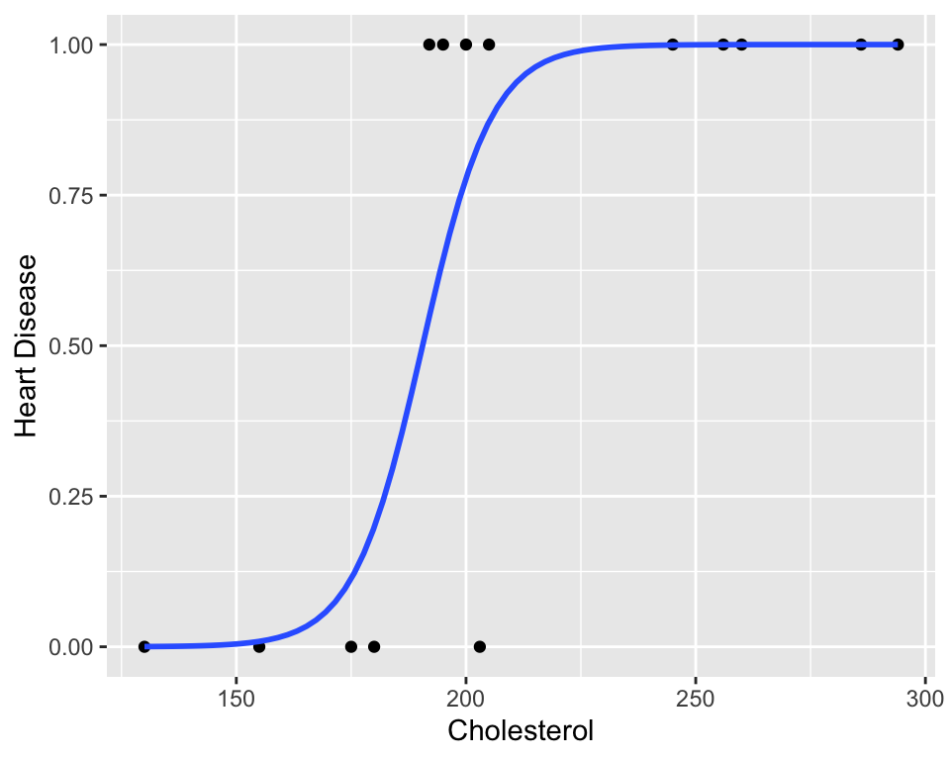
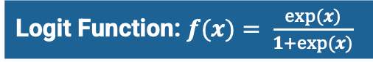
Logit Function: $f(x)= \frac{exp(x)}{1+exp(x)}$

Slide 31

$Y$ – Probability of Getting a Heart Disease
$$Logit \{Y\}=β_{0}+β_{1}Cholesterol$$
$$Logit Y=Log \left[\frac{Y}{1−Y}\right]=β_{0}+β_{1}Cholesterol$$
This is also equivalent to:
$$Y= \frac{exp(β_{0}+β_{1}Cholesterol)}{1+exp(β_{0}+β_{1}Cholesterol)}$$

Slide 32
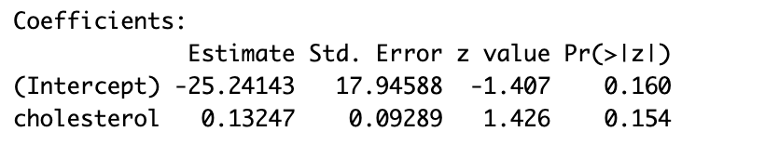


logistic_regression = glm(formula = heart_disease ~ cholesterol,
data = loan_df,family = 'binomial’)
summary(logistic_regression)
$$logit \left(\hat{Y}\right)=−25.24+0.13 \text{Cholesterol}$$
$$\hat{Y}=\frac{\exp{(−25.24+0.13 \text{Cholesterol})}}{1+\exp\left(−25.24+0.13 \text{Cholesterol}\right)}$$
$\hat{Y}$ - Probability of getting a heart disease given the Cholesterol Level
If $Y>0.5 →\text{H}\text{eart} \text{D}\text{isease}$
We can change 0.5 to a different probability threshold.

Slide 33
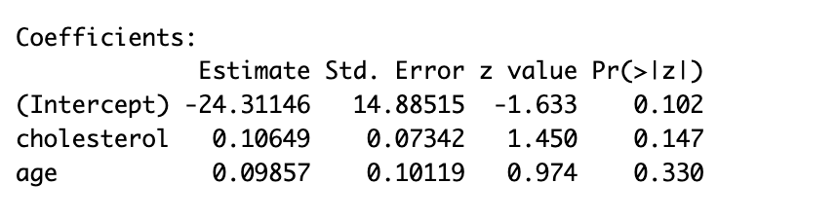
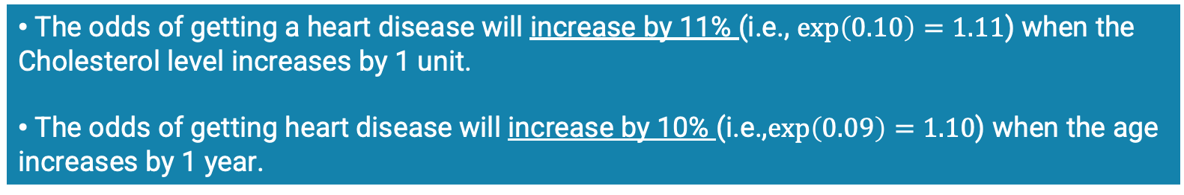

logistic_regression = glm(formula = heart_disease ~ cholesterol + age ,
data = loan_df,family = 'binomial')
summary(logistic_regression)
$$logit \left(\hat{Y}\right)=−24.3+0.10 Cholesterol+0.09 Age$$
$$\hat{Y}=\frac{\exp{(−24.3+0.10 Cholesterol+0.09 Age)}}{1+\exp\left(−24.3+0.10 Cholesterol+0.09 Age\right)}$$
$\hat{Y}$ - Probability of approving the loan when income and age is known
The odds of getting a heart disease will increase by 11% (i.e., $exp\left(0.10\right)=1.11$) when the Cholesterol level increases by 1 unit.
The odds of getting heart disease will increase by 10% (i.e.,$exp\left(0.09\right)=1.10$) when the age increases by 1 year.

Slide 34
Random Forest: Classification

Slide 35
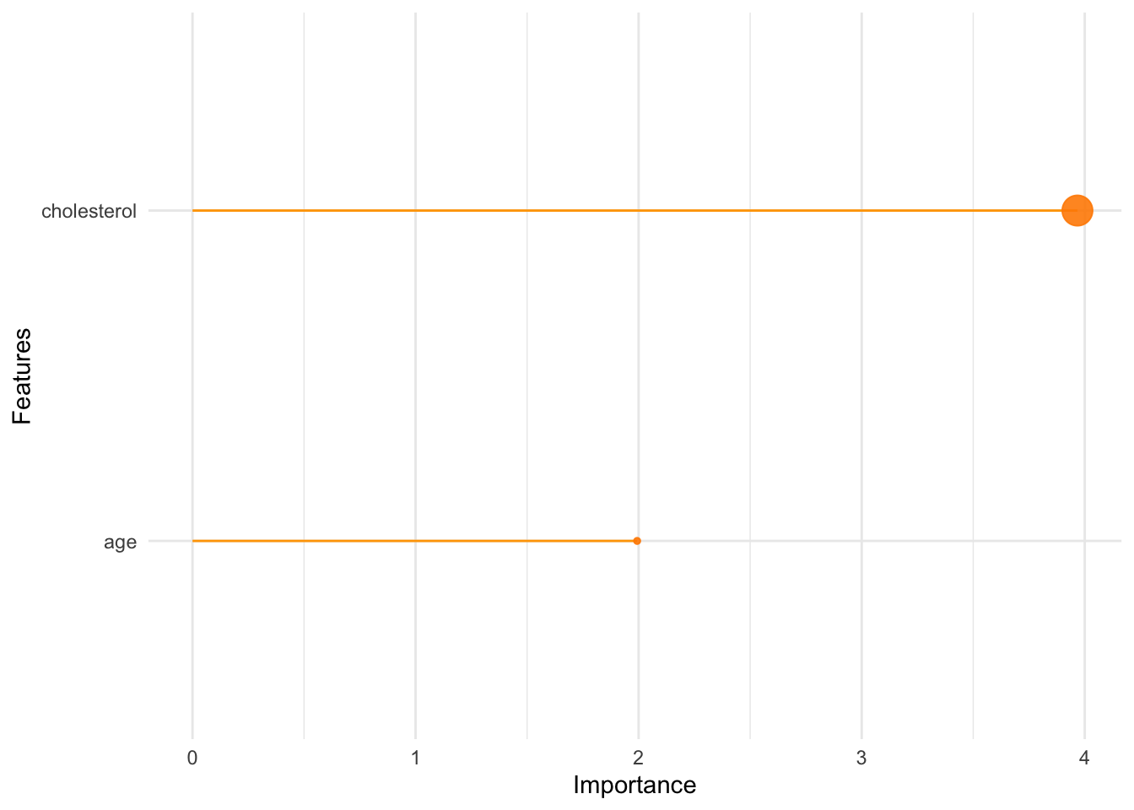
library(randomForest)
Random_Forest_Classifier = randomForest(as.factor(heart_disease) ~ cholesterol + age, data=heart_df, importance = TRUE, ntree=500)

Slide 36
Comparison of Logistic Regression and Random Forest
Logistic Regression | Random Forest Classification
Linear Model Works well when data is linear | Non-linear Model Work well with both linear and nonlinear data Ensemble Technique Take the average prediction of multiple models
Works with two classes - Multinomial logistic regression shall be used to for than 2 classes | Can extend for multiple classes
Model Interpretation A better interpretation of variables | Model Interpretation is moderate Not best as the logistic regression

Slide 37


Evaluate Model Performance in Classification
Confusion Matrix
Actual Classes
 | 0 | 1
0 | True Negative | False Negative
1 | False Positive | True Positive
Predicted Classes
$$Accuracy= \frac{TP+TN}{N}$$
$$Precision= \frac{TP}{TP+FP}$$
$$Sensitivity=True Positive Rate= \frac{TP}{TP+FN}$$
$$Specificity=1−False Positive Rate= \frac{TN}{TN+FP}$$
N – Total Number of Observations

Slide 38
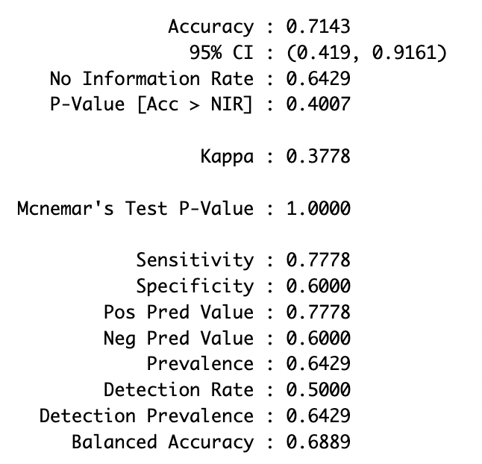
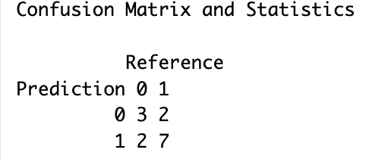
Evaluate Model Performance in Classification
library(caret)
random_forest_prediction = predict(Random_Forest_Classifier)
observed_data = as.factor(heart_df$heart_disease)
confusionMatrix( random_forest_prediction, observed_data, positive = '1')

Slide 39
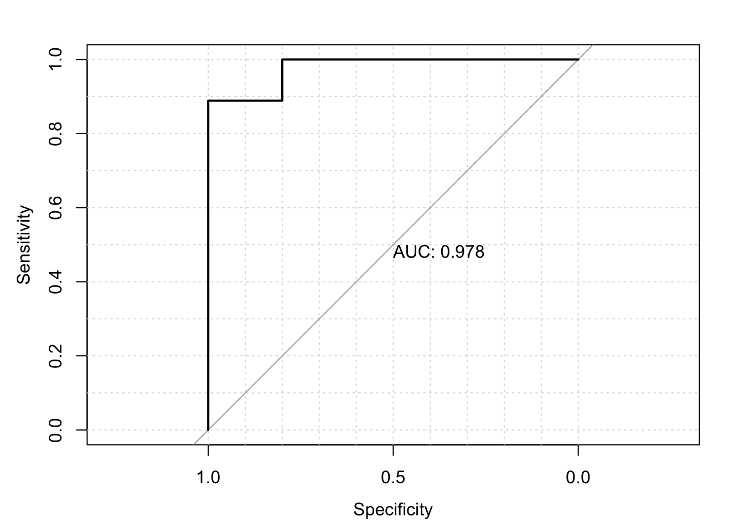
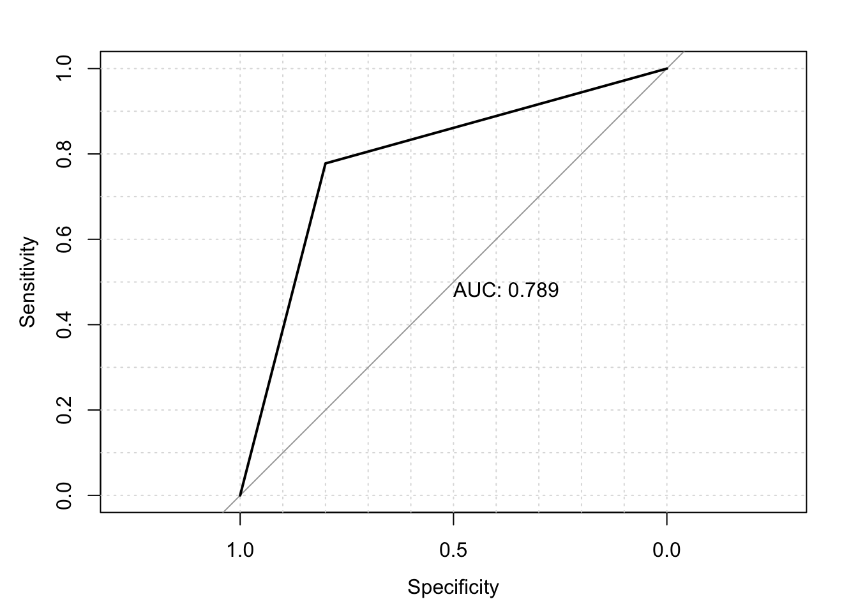

Evaluate Model Performance in Classification
Receiver Operating Characteristic (ROC) Curve
Logistic Regression
Random Forest Classifier
ROC curve is a plot between the Sensitivity and Specificity of a classification model
If the area under the curve is 0.5, we are making random guesses
If the area under the curve is close to 1, we are making accurate predictions
$$Sensitivity= \frac{TP}{TP+FN}$$
$$Specificity= \frac{TN}{TN+FP}$$

Slide 40
Overfitting & Cross-Validation

Slide 41
Overfitting in Regression
y
y
y
x
x
x
Underfit
– less complex model
Better Fit
- moderately complex model
Overfit
– high complex model

Slide 42






Overfitting in Classification
$$x_{2}$$
$$x_{2}$$
$$x_{2}$$
$$x_{1}$$
$$x_{1}$$
$$x_{1}$$
Underfit
– less complex model
Better Fit
- moderately complex model
Overfit
– high complex model

Slide 43
How to Overcome Overfitting
Train/Test Data Split
Training Data
Test Data
All Data Set
Error
Training Error
Test Error
Model Complexity
Error = Actual - Predicted

Slide 44
How to Overcome Overfitting
K-Fold Cross-Validation
Train Data
Train Data
Train Data
Train Data
Validation Data
All Train Data
Train Data
Train Data
Train Data
Validation Data
Train Data
K-Fold Cross Validation Error
Take average of all Validation Errors
Train Data
Train Data
Validation Data
Train Data
Train Data
Train Data
Validation Data
Train Data
Train Data
Train Data
Validation Data
Train Data
Train Data
Train Data
Train Data

Slide 45
How to Overcome Overfitting
K-Fold Cross-Validation
Error
K-Fold Cross Validation Error
Better Model
Model Complexity

Slide 46


Hyperparameter Tuning
Equipment 1 Settings
Equipment 2 Settings

Slide 47
Hyperparameter Tuning
Model 1 Settings
Model 2 Settings

Slide 48
Hyperparameter Tuning
Hyperparameters
Model specific parameters which can not be estimated with data
Example: ntrees and mtry in Random Forest
Grid Search
Require to find optimal values with a search
Model Validation Error
Hyperparameter 2
Optimal Value
Hyperparameter
Hyperparameter 1

Slide 49
Training Data
Use to Train Model
Validation Data
Use to control overfit
Use to tune model parameters
Test Data
Test model with unseen data

Slide 50
Session 2: Part 2 Unsupervised Learning Workshop on Quantitative Literacy and Statistics

Slide 51
Unsupervised Learning
Learning techniques to find a patterns and cluster unlabeled data
Data Set
Cluster 1
Cluster 2
Cluster 3

Slide 52
K-Means Clustering

Slide 53


$$x_{2}$$
Assign data points for the closest centroid
$$x_{1}$$

Slide 54
$$x_{2}$$
Now update the center of the centroids
$$x_{1}$$

Slide 55
$$x_{2}$$
Now update the center of the centroids
$$x_{1}$$

Slide 56
$$x_{2}$$
Find the the closest points and and update the centroid
Repeat the process
$$x_{1}$$

Slide 57
$$x_{2}$$
Find the the closest points and and update the centroid
Repeat the process
$$x_{1}$$

Slide 58
$$x_{2}$$
Find the the closest points and and update the centroid
Repeat the process
$$x_{1}$$

Slide 59
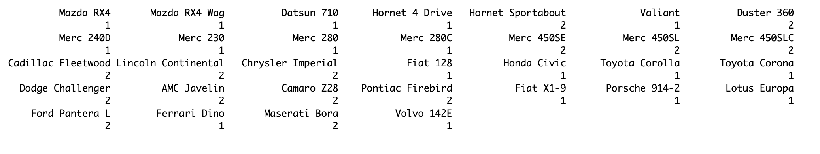
K-Means Clustering
set.seed(123)
k_means_clustering <- kmeans(mtcars, centers = 2)
print(k_means_clustering$cluster)

Slide 60
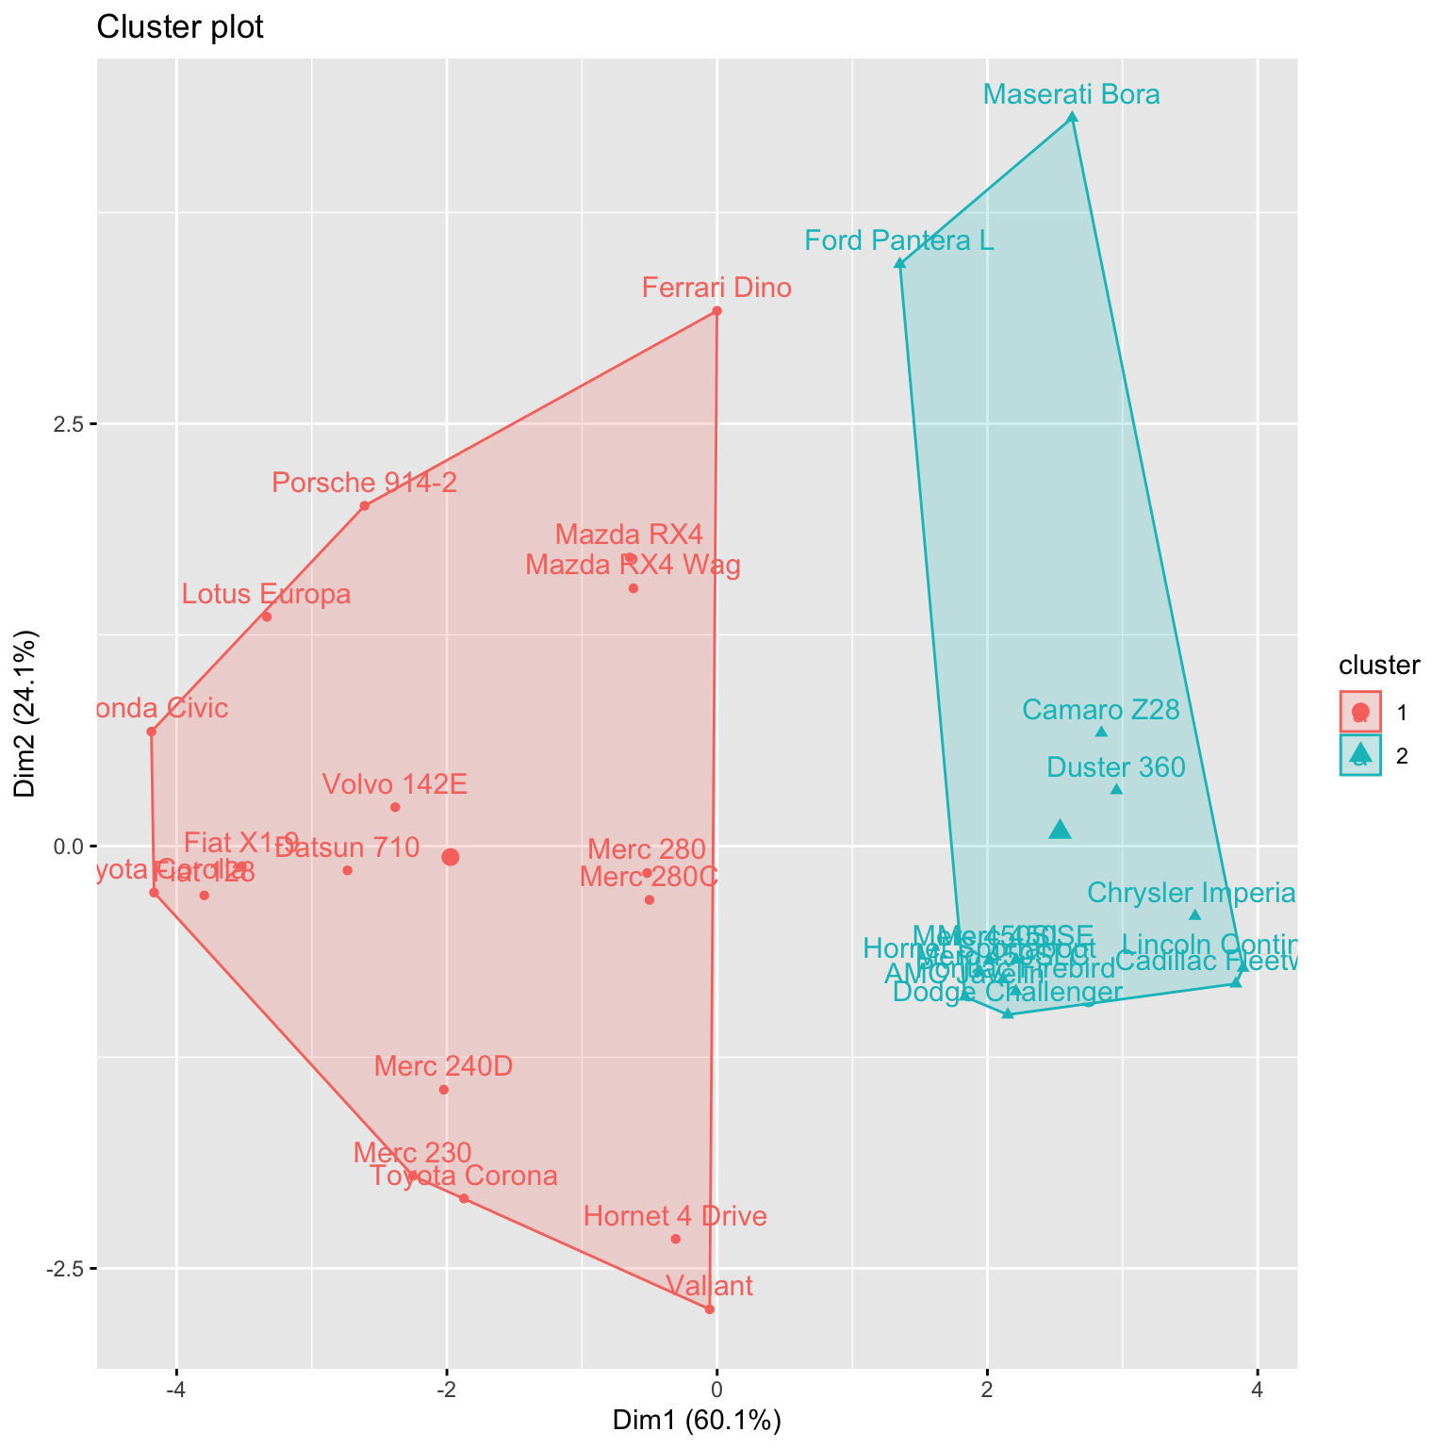
Plot K-Means Clustering
library(factoextra)
fviz_cluster(k_means_clustering, data = mtcars)

Slide 61
Hierarchical Clustering

Slide 62
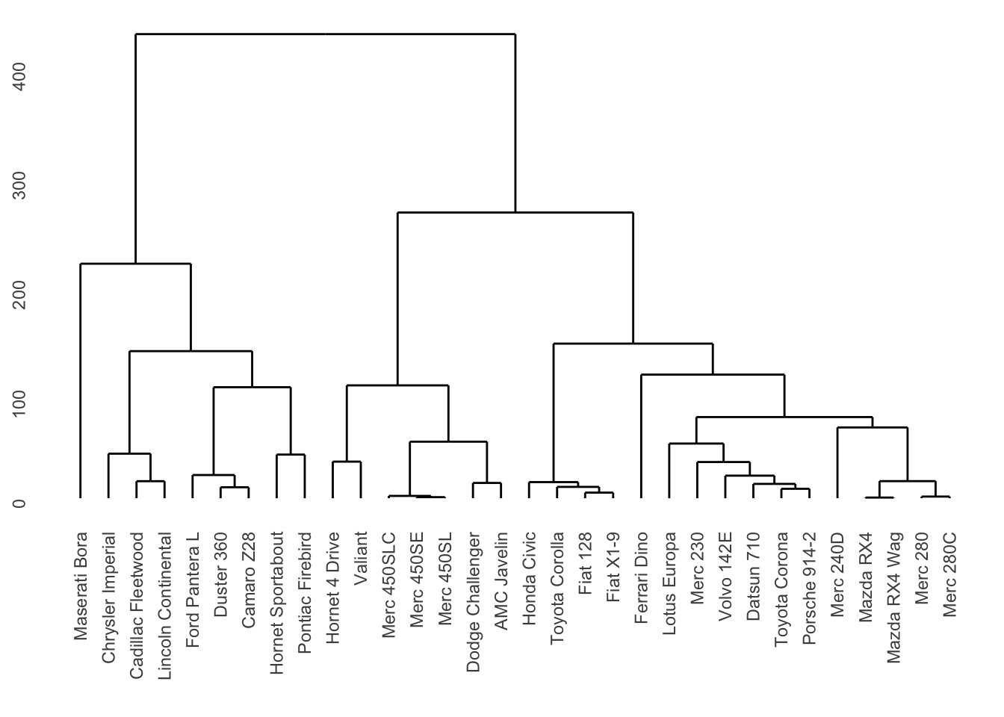
library(ggdendro)
set.seed(123)
mtcars_distance = dist(mtcars, method = 'euclidean')
h_clustering = hclust(mtcars_distance)
ggdendrogram(h_clustering)

Slide 63
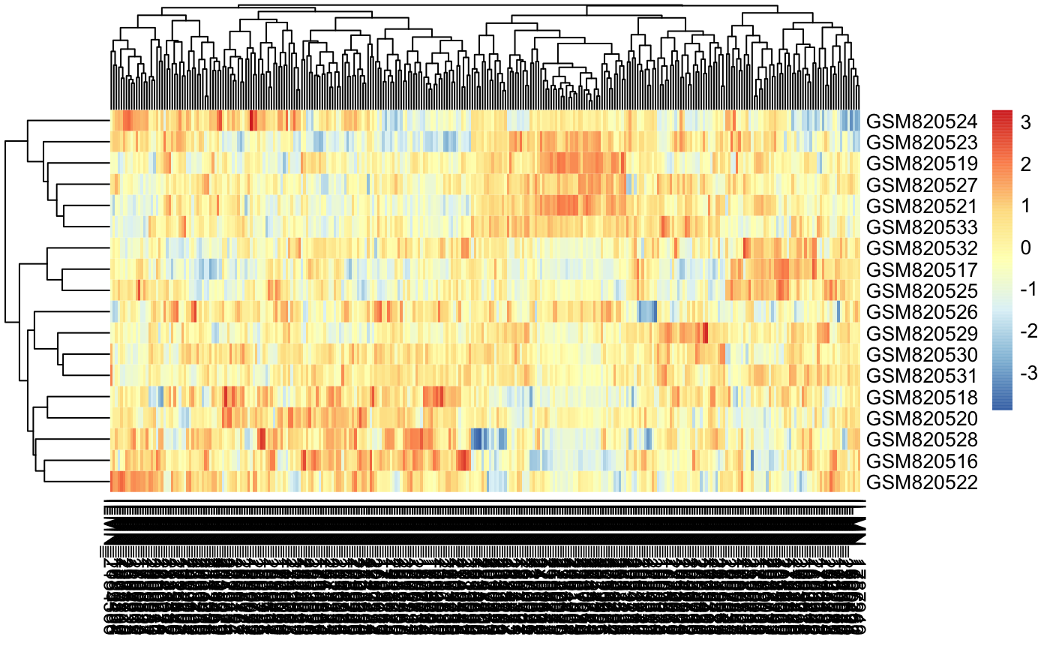
Hierarchical-Means Clustering based heatmaps are popular in analyzing gene expression data

Slide 64
Principal Component Analysis Biplot

Slide 65
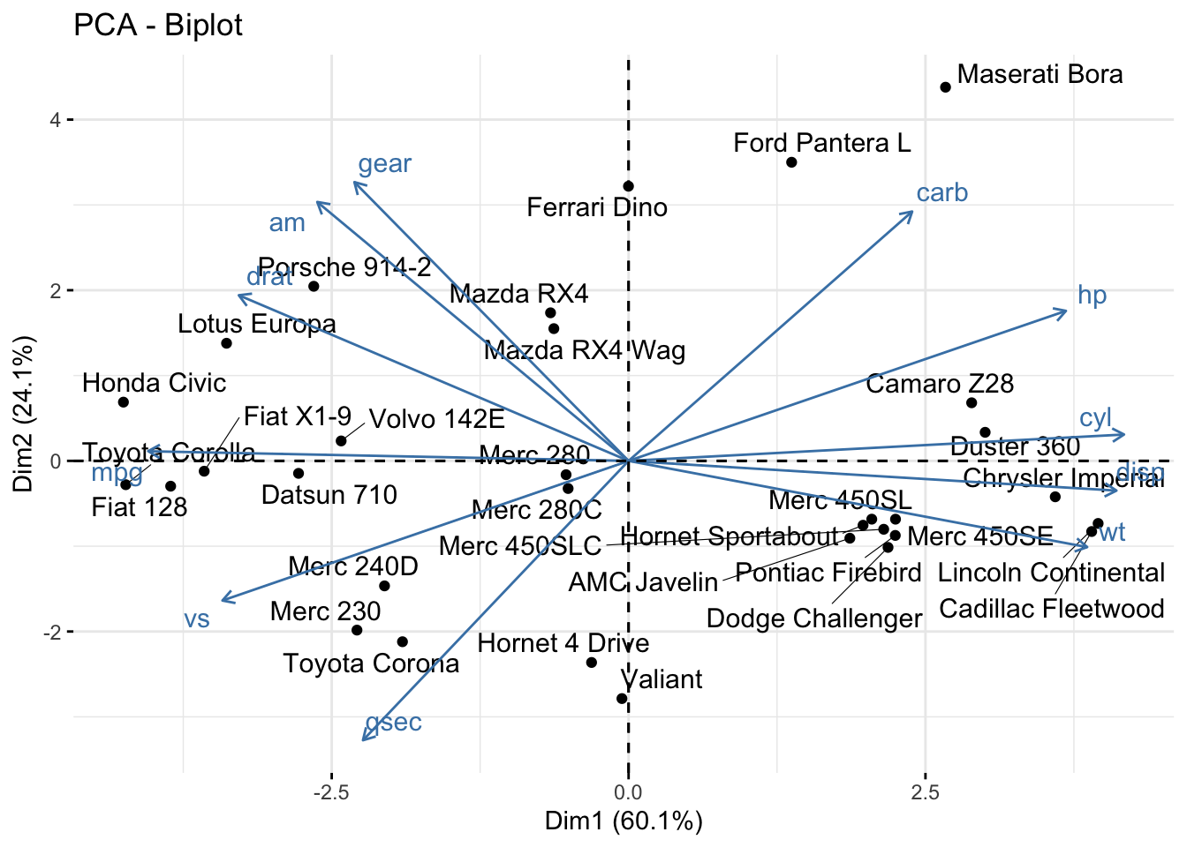
library(FactoMineR)
pca_mtcars <- PCA(mtcars, graph = FALSE)
fviz_pca_biplot(pca_mtcars, repel = TRUE)
PCA Biplot can be used to understand the correlation structure of the variables

Slide 66
Statistical Learning
Supervised Learning
Unsupervised Learning
Regression
Classification
Thank you!

